Slide 1







Regularized Simultaneous Component Analysis
Katrijn Van Deun, Tilburg University

Slide 2


Slide 3
Outline
Introduction: Motivation & Challenges
Methods: Sparse Common Components
Model
Objective function
Estimation
Model Selection
Illustrations
Exploration: 500 families
Prediction: Systems vaccinology
Conclusion & Discussion

Slide 4
Introduction

Slide 5
Big Data in the Social Sciences
Everything is measured
What we think and do: Social media, Web browsing behavior
Where we are and with whom: GPS tracking, cameras
At a very detailed level: Experience sampling, neuron, DNA
Data are shared
Open data: in science, governments (open government data)
Data are linked
Government
Science: multi-disciplinary
Linked Data web-architecture

Slide 6
1 … 500
1
.
.
.
.
.
.
.
.
.
.
.
.
.
.
10 000
Respondents
Survey / Questionnaire data
Well being
Illustration: Health & Retirement Study; traditional data

Slide 7
1 … 500
501 … 50 000
1
.
.
.
.
.
1000
Survey
data
Novel kind of data
Well being
Respondents
Illustration: Health & Retirement Study; traditional + novel type of data
Multiple sources, heterogeneous in nature
High-dimensional (p>>n)
Big Data

Slide 8

Illustration: ALSPAC household panel data
Multiple sources / multi-block (heterogeneous)
High-dimensional
(no outcome)
(epi)-genetic
survey
respondents
questionnaire

Slide 9
Illustration: ALSPAC household panel data
Multi-source data with outcome
1 … 10
1 … 100
1 … 10000
1
.
.
.
.
.
1000
Register
data
Questionnaire data
Indic.
Obes.
Respondents
(Epi)-Genetic data

Slide 10
Extremely information-rich data
1) Adds context, detail => deeper understanding + more accurate prediction
Eg. Same income, social network, health but difference in well-being?
2) Gives insight in the interplay between multiple factors / system point of view
Eg. gene-environment interactions: find (epi-)genetic markers that make someone susceptible to obesity together with the protective/risk-provoking environmental conditions associated to these markers
However, statistical tools fall short …

Slide 11
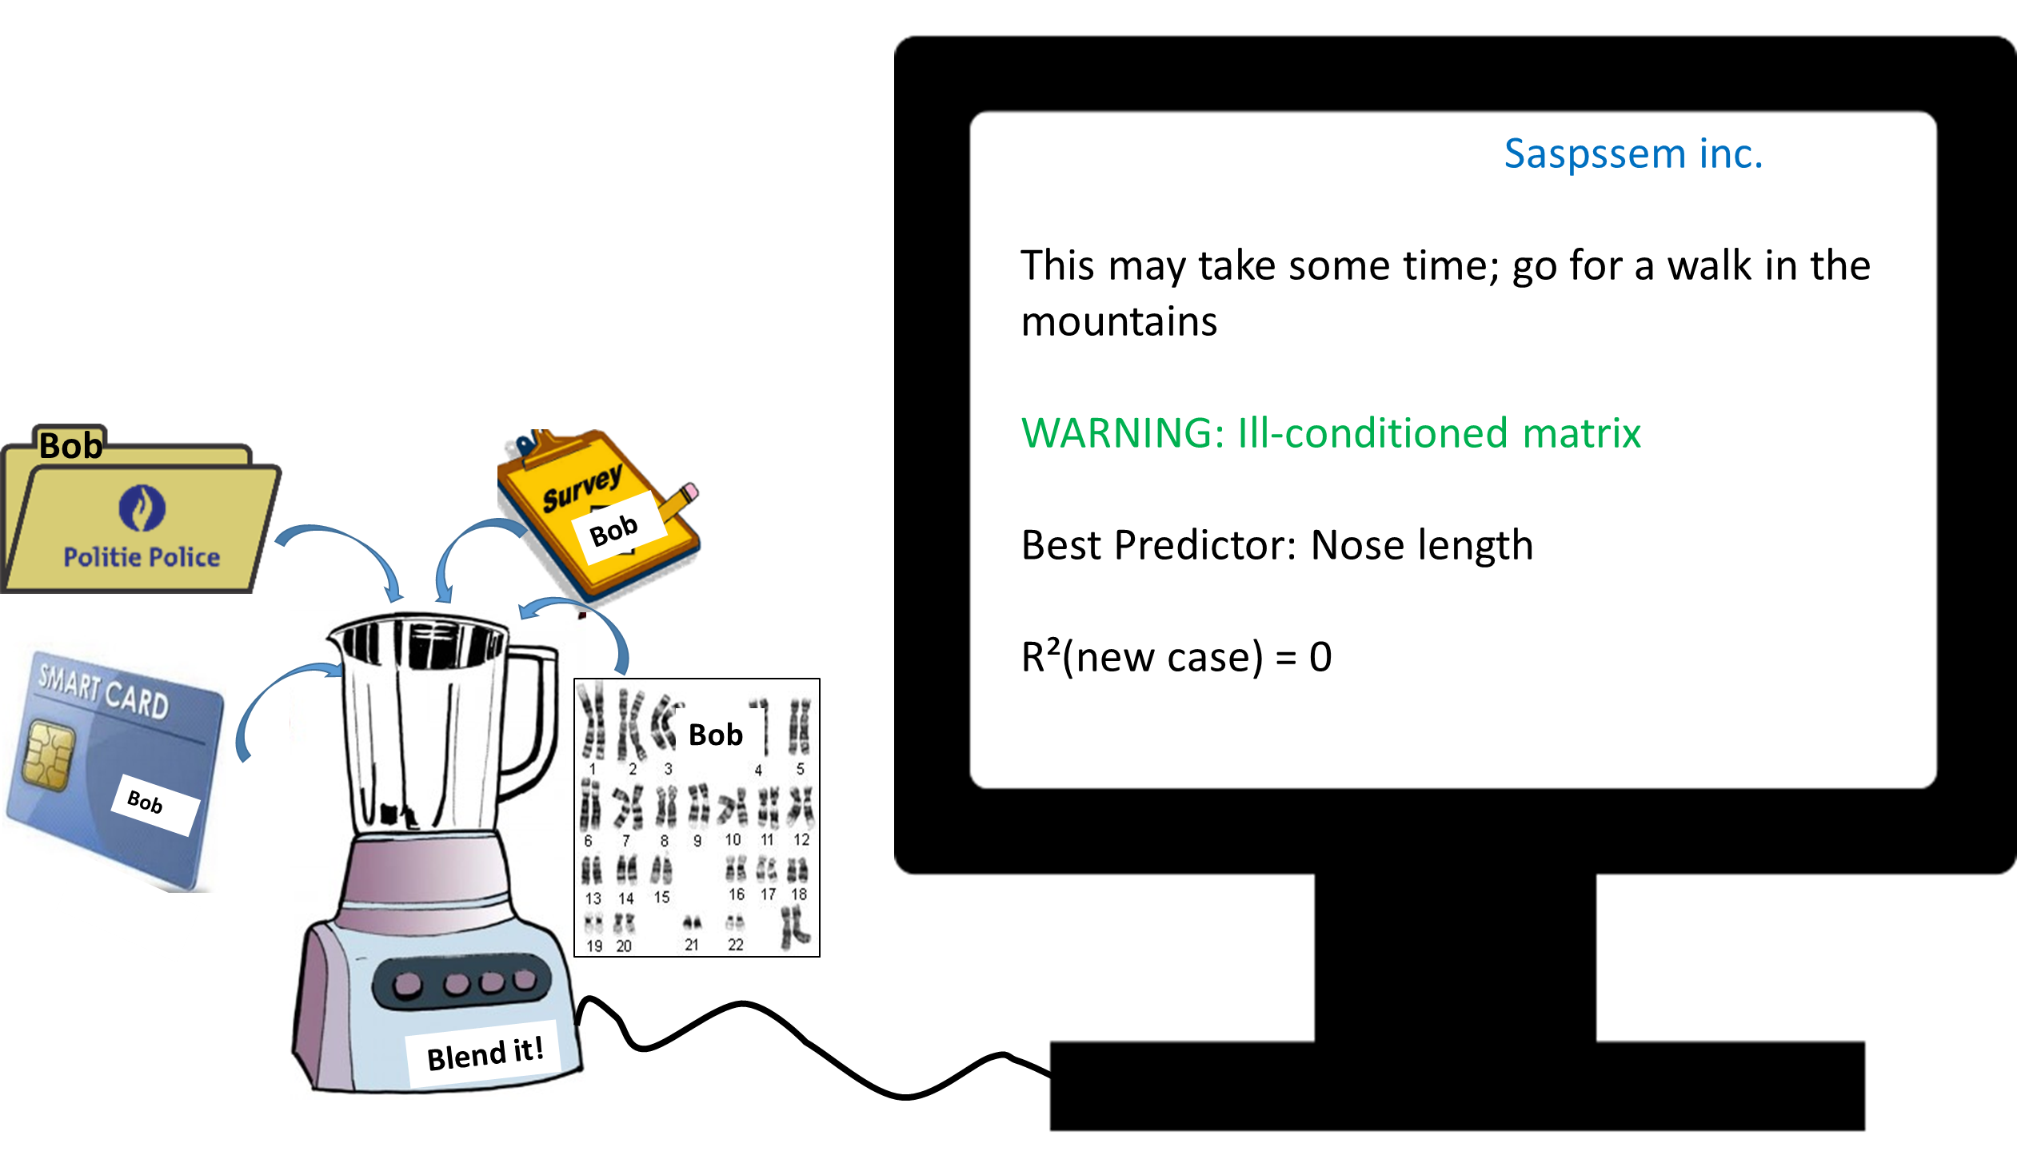

Slide 12
First challenge = Data fusion?
How to guarantee that the different sources of variation complement each other?
Find common sources of structural variation?
Yet, heterogeneous data sources; often common sources of variation are subtle while source-specific variation is dominant
Often different measurement levels, very different sizes of data blocks
Stronger correlations of variables within blocks than between blocks
Eg, response tendencies, general psychological processes
Eg, (general) biological processes
Notes:
Decline in cognitive health: gene-environment interactions

Slide 13
Second challenge = Relevant variables?
Find relevant variables
Information may be hidden in a bulk of irrelevant variables
e.g., genetic markers for obesity hidden in a bulk of irrelevant markers
Interpretation based on many variables is not very insightful
Note: in general, we do not know which variables are relevant and which are not
S-O-A: penalties, eg lasso
However: selects only one variable out of a group of correlated variables
(i) have a high risk of not selecting the most relevant variable,
(ii) are highly instable, and
(iii) tend to also select variables of irrelevant groups
Notes:
Decline in cognitive health: gene-environment interactions

Slide 14
Method: Sparse common and specific components

Slide 15
Method: Sparse common & specific components
Structured analysis
Data fusion: Common components
Detection of relevant variables: Penalties (eg lasso)
=> Selection of linked variables (between blocks)
1 … 500
501 … 50 000
1
.
.
.
.
.
1000
Survey
data
Nieuw soort data
Well being
Respondents

Slide 16
Notation and naming conventions
data block: denotes the different data sources forming the multiblock data
X_{k} : data block k (with k=1,…,K ); the outcome(s) is denoted by Y (y if univariate)
Each of the data blocks: same set of observation units (respondents)
1 … 500
501 … 50 000
1
.
.
.
.
.
1000
X₁: Survey
data
X₂: Novel kind of data
Y: Well being
Respondents

Slide 17
Method: Data fusion
Point of departure = Simultaneous component analysis (SCA)
Extension of PCA to the multiblock case
Promising method for data integration

Slide 18
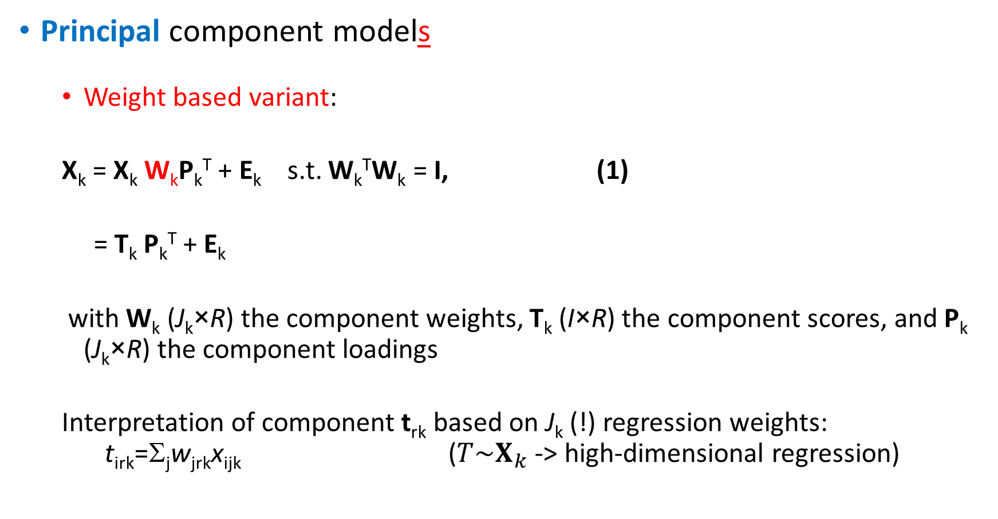
Principal component models
Weight based variant:
X_{k} = X_{k} W_{k}P_{k}^{T} + E_{k} s.t. W_{k}^{T}W_{k} = I, (1)
= T_{k} P_{k}^{T} + E_{k}
with W_{k} (J_{k}×R) the component weights, T_{k} (I×R) the component scores, and P_{k} (J_{k}×R) the component loadings
Interpretation of component t_{rk} based on J_{k} (!) regression weights: t_{irk}=Σ_{j}w_{jrk}x_{ijk} ($T\sim X_{k}$ -> high-dimensional regression)

Slide 19
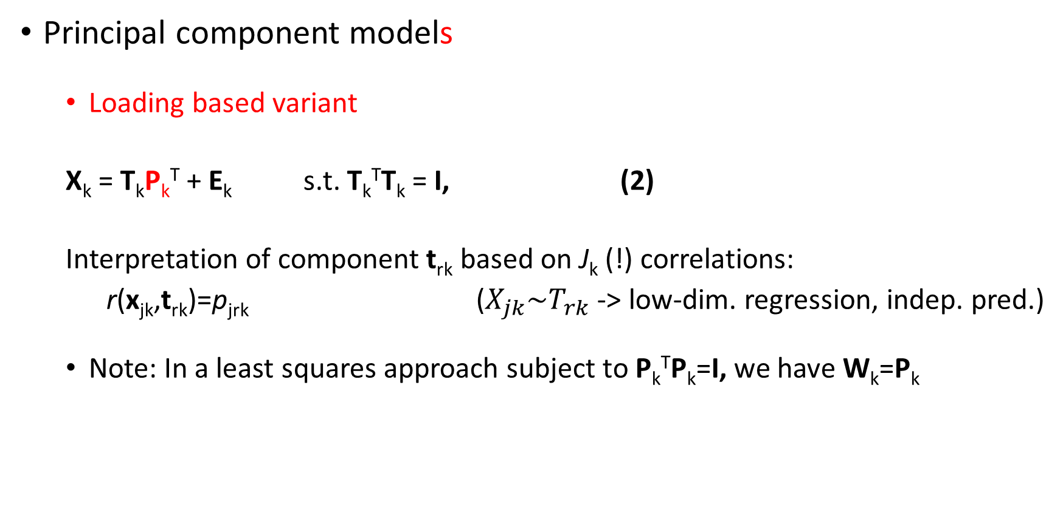
Principal component models
Loading based variant
X_{k} = T_{k}P_{k}^{T} + E_{k} s.t. T_{k}^{T}T_{k} = I, (2)
Interpretation of component t_{rk} based on J_{k} (!) correlations:
r(x_{jk},t_{rk})=p_{jrk} ($X_{jk}\sim T_{rk}$ -> low-dim. regression, indep. pred.)
Note: In a least squares approach subject to P_{k}^{T}P_{k}=I, we have W_{k}=P_{k}
Notes:
19

Slide 20
Simultaneous component analysis
For all k:
X_{k} = TP_{k}^{T} + E_{k} s.t. T^{T}T=I (3)
->same component scores for all data blocks!
1. Weight based variant:
[X₁ ... X_{K}] = T [P₁^{T} ... P_{K}^{T}] + [E₁ ... E_{K}^{T}]
= [X₁ ... X_{K}] [W₁^{T} ... W_{K}^{T}]^{T} [P₁^{T} ... P_{K}^{T}] + [E₁ ... E_{K}^{T}]
or, in shorthand notation:
X_{conc} = X_{conc} W_{conc} P_{conc}^{T} + E_{conc} (4)
2. Loading based variant:
X_{conc} = T P_{conc}^{T} + E_{conc} (5)
Notes:
20

Slide 21
Simultaneous components
Guarantee same source of variation for the different data blocks
But … do not guarantee that the components are common!
Model the largest source of variation in the concatenated data, often this is source-specific variation or a mix of common and specific variation
See also Schouteden et al. (BRM, 201x): Rotation to common & specific components

Slide 22
Common component analysis (CCA)
Account for dominating source specific variation
Common component model:
X_{conc} = TP_{conc}’ such that T’T=I and P_{conc} has common / specific structure
Structure can be imposed (constrained analysis)
Or: X_{k}= X_{conc}W_{conc}P_{k}’ with the W_{conc} having common / specific structure
 | P1 |  |  | P2
Common | x | x | x | x | x | x | x
Spec1 | x | x | x | 0 | 0 | 0 | 0
Spec1 | 0 | 0 | 0 | x | x | x | x

Slide 23
So far, so good …
Yet:
Interest in relevant / important variables (social factors, genetic markers)?
Interpretation of the components based on 1000s of loadings/weights is infeasible
Need to automatically select the “relevant” variables!
Sparse common components are needed.

Slide 24
Structured sparsity:
Sparse common components: few non-zero loadings in each data block X_{k}
(Sparse) specific components: (few) non-zero loadings only in one/few data blocks X_{k}
 | X1 |  |  | X2
Common | x | 0 | 0 | x | x | 0 | x
Dist1 | x | x | x | 0 | 0 | 0 | 0
Dist1 | 0 | 0 | 0 | x | 0 | x | x

Slide 25
Variable selection: How to?
Sparse analysis
Impose restriction on the loadings/weights: many should become zero
S-O-A: add penalties (e.g., lasso) to the objective function

Slide 26
Why not rotation to simple structure?
Must read : Cadima & Jolliffe (1995)
Ordinary simultaneous component analysis, common interpretation practice (VARIMAX + thresholding)
%VAF: .31 (if calculated with neglected loadings set equal to zero)
Sparse SCA, lasso in action
%VAF: .35 (>.31, VARIMAX!!!!)

Slide 27
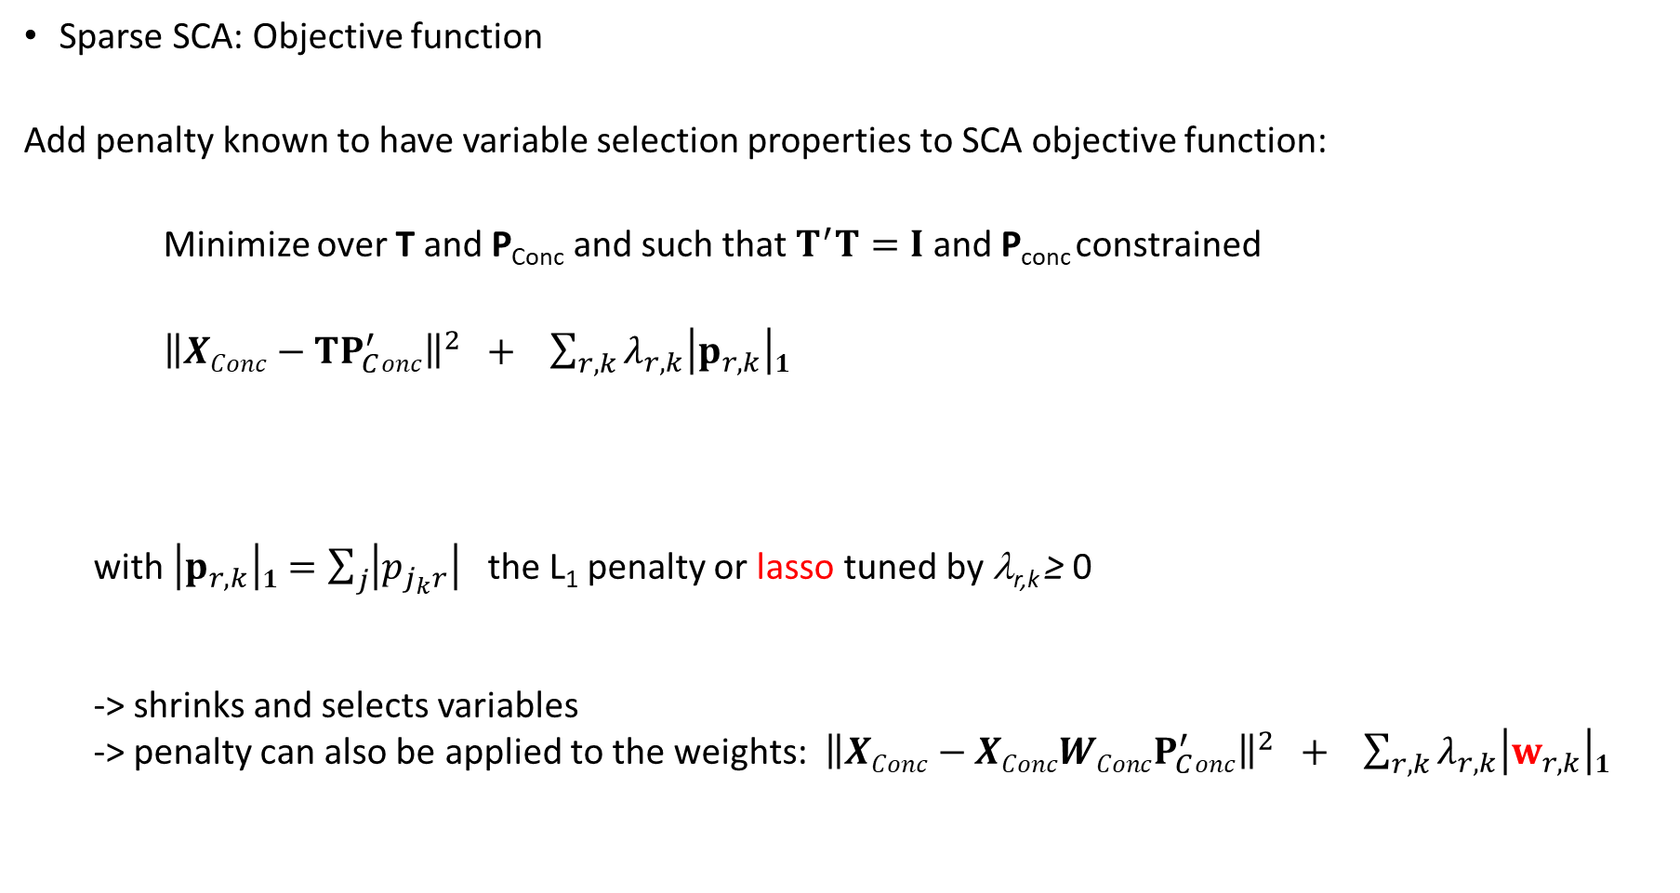
Sparse SCA: Objective function
Add penalty known to have variable selection properties to SCA objective function:
Minimize over T and P_{Conc} and such that $T^{′}T=I$ and P_{conc} constrained
${\left\|XConc−TP_{C}^{′}onc\right\|}^{2} + \sum_{r,k}{λ_{r,k}\left|p_{r,k}\right|1}$
with $\left|p_{r,k}\right|1=\sum_{j}{\left|p_{j_{k}r}\right|}$ the L₁ penalty or lasso tuned by λ_{r,k} ≥ 0
-> shrinks and selects variables
-> penalty can also be applied to the weights: ${\left\|XConc−XConcWConcP_{C}^{′}onc\right\|}^{2} + \sum_{r,k}{λ_{r,k}\left|w_{r,k}\right|1}$
Fit / SCA
Penalty

Slide 28
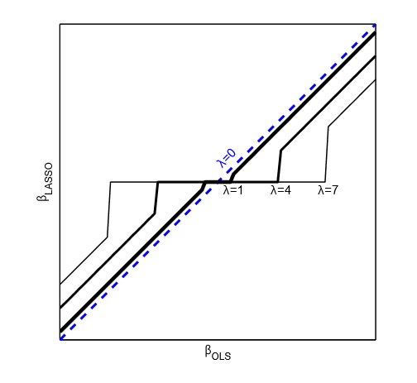
Lasso
Oracle properties (under some conditions)
Estimation: soft thresholding operator S(β_{OLS}, λ/2)
= β_{OLS} – λ/2 if β_{OLS}>λ/2
β_{LASSO} = 0 if – λ/2 <β_{OLS}<λ/2
= β_{OLS} – λ/2 if β_{OLS}<-λ/2
0

Slide 29
Algorithm: Alternating procedure
Given fixed tuning parameters and number of common and distinctive components, do
0. Initialize P_{conc}
1. Update T conditional upon P_{conc}
Closed form: T=UV’ with U and V from the SVD of X_{C}P (I×R -> small for H-D data)
2. Update P_{conc} conditional upon T
Coordinate descent (see next)
3. Check stop criteria (convergence of the loss, maximum number of iterations) and return to step 1 or terminate

Slide 30

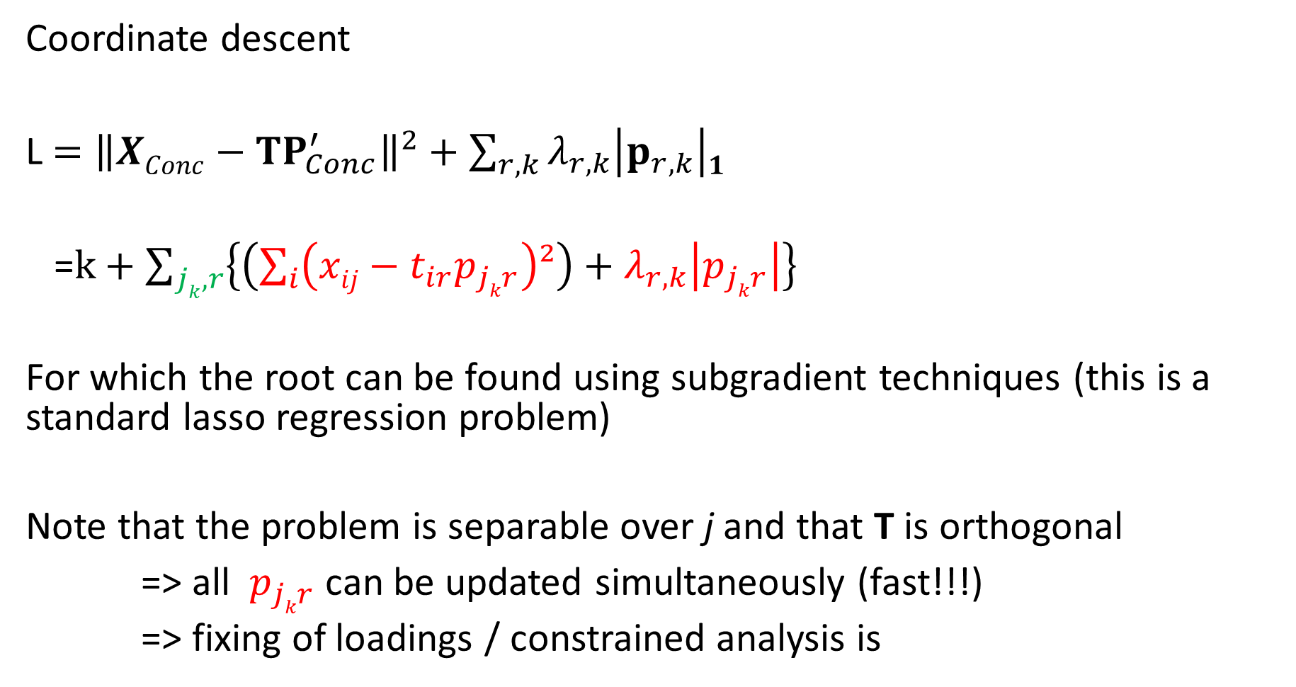
Coordinate descent
L $={\left\|XConc−TP_{Conc}^{′}\right\|}^{2}+\sum_{r,k}{λ_{r,k}\left|p_{r,k}\right|1}$
=$k+\sum_{jk,r}{\left\{\left(\sum_{i}{\left(xij−t_{ir}p_{jkr}\right)²}\right)+λ_{r,k}\left|p_{jkr}\right|\right\}}$
For which the root can be found using subgradient techniques (this is a standard lasso regression problem)
Note that the problem is separable over j and that T is orthogonal
=> all $p_{jkr}$ can be updated simultaneously (fast!!!)
=> fixing of loadings / constrained analysis is
Notes:
D: not same as D1 to account for component specific value of the penalty tuning parameter

Slide 31
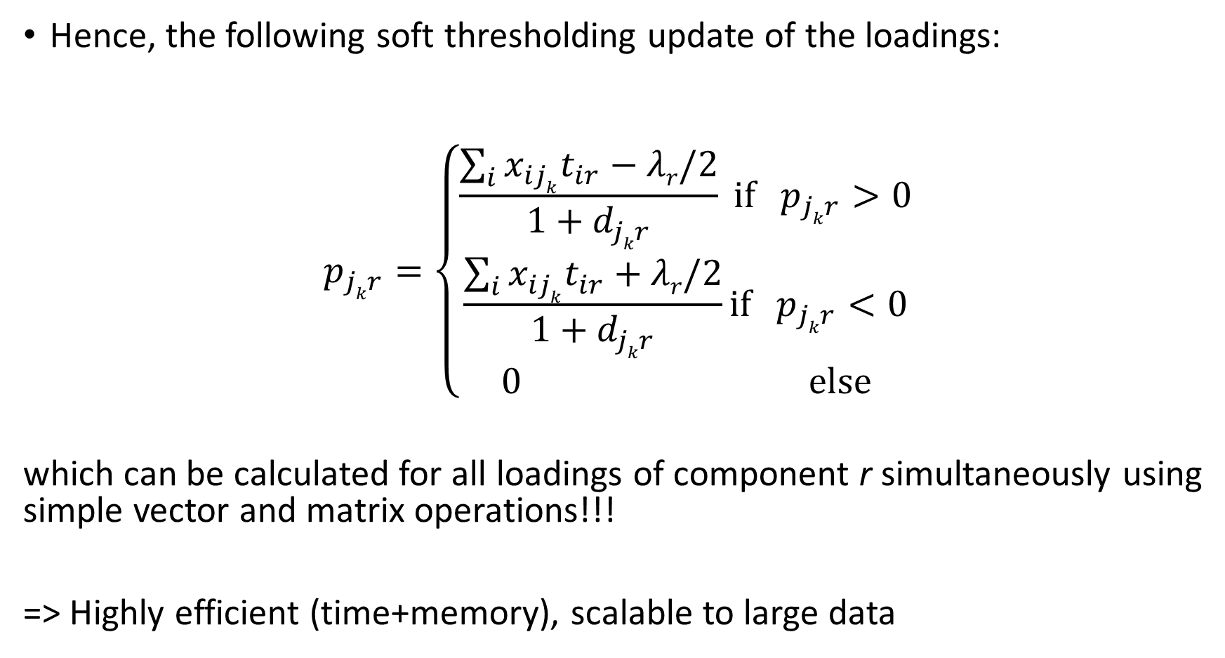
Hence, the following soft thresholding update of the loadings:
$$p_{jkr}=\left\{\begin{matrix}\frac{\sum_{i}{x_{ijk}t_{ir}−λr/2}}{{1+d}_{jkr}} \text{i}\text{f}{ p}_{jkr}>0 \\ \frac{\sum_{i}{x_{ijk}t_{ir}+λr/2}}{{1+d}_{jkr}}\text{i}\text{f}{ p}_{jkr}<0 \\ 0 \text{else}\end{matrix}\right.$$
which can be calculated for all loadings of component r simultaneously using simple vector and matrix operations!!!
=> Highly efficient (time+memory), scalable to large data

Slide 32

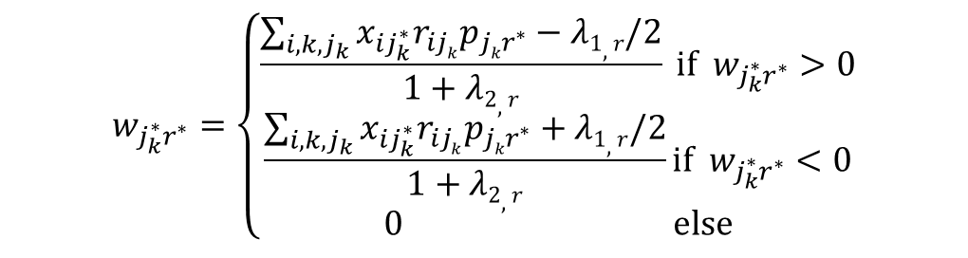
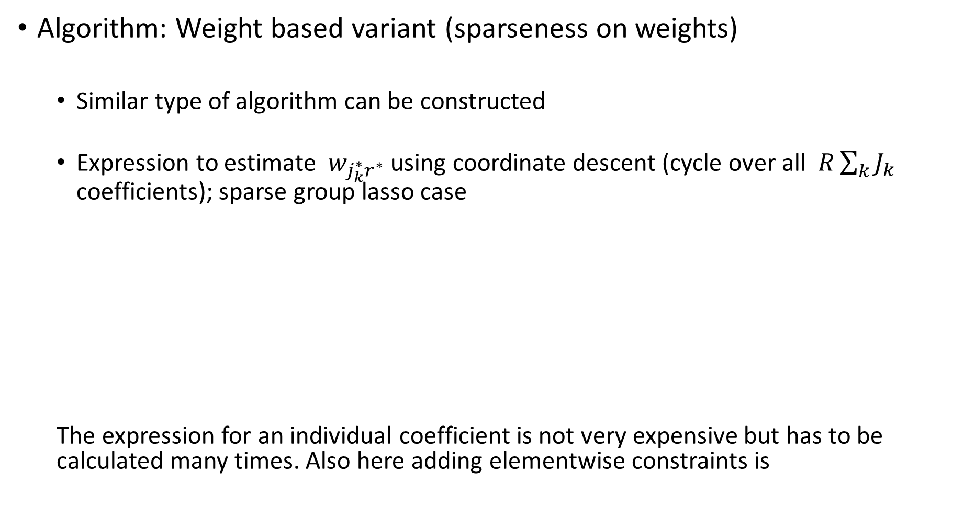
Algorithm: Weight based variant (sparseness on weights)
Similar type of algorithm can be constructed
Expression to estimate $w_{j_{k}^{∗}r^{∗}}$ using coordinate descent (cycle over all $R\sum_{k}{J_{k}}$ coefficients); sparse group lasso case
The expression for an individual coefficient is not very expensive but has to be calculated many times. Also here adding elementwise constraints is
$$w_{j_{k}^{∗}r^{∗}}=\left\{\begin{matrix}\frac{\sum_{i,k,j_{k}}{x_{ij_{k}^{∗}}r_{ijk}p_{{jkr}^{∗}}−λ1,r/2}}{1+λ2,r} \text{i}\text{f} w_{j_{k}^{∗}r^{∗}}>0 \\ \frac{\sum_{i,k,j_{k}}{x_{ij_{k}^{∗}}r_{ijk}p_{{jkr}^{∗}}+λ1,r/2}}{1+λ2,r}\text{i}\text{f} w_{j_{k}^{∗}r^{∗}}<0 \\ 0 \text{else}\end{matrix}\right.$$
Ridge penalty has to be included

Slide 33
Algorithm
Coordinate-wise approach allows to fix coefficients
This can be used to define the specific components by fixing to zero those coefficients corresponding to the block(s) that is not accounted for by the component

Slide 34
Model selection
Number of components R, penalty tuning parameters and/or status (common or specific):
How to select suitable values?
No definite answer, only suggestions
R: inspect VAF
Use stability selection to tune variable selection (λ_{L})
Cross-validation
Exhaustive strategy for status if nr blocks & components limited

Slide 35
Some illustrations

Slide 36
500 Family Study (Schneider & Linda, 2008)
Three data blocks: 195 families
Father -> 8 questionnaires
Mother -> 8 questionnaires
Child -> 7 questionnaires
Here: part of questionnaires
Analyzed with the RegularizedSCA package (available from CRAN)
This is the sparse loading variant
Several options for model selection; includes the DISCO rotation
Exploratory analysis

Slide 37
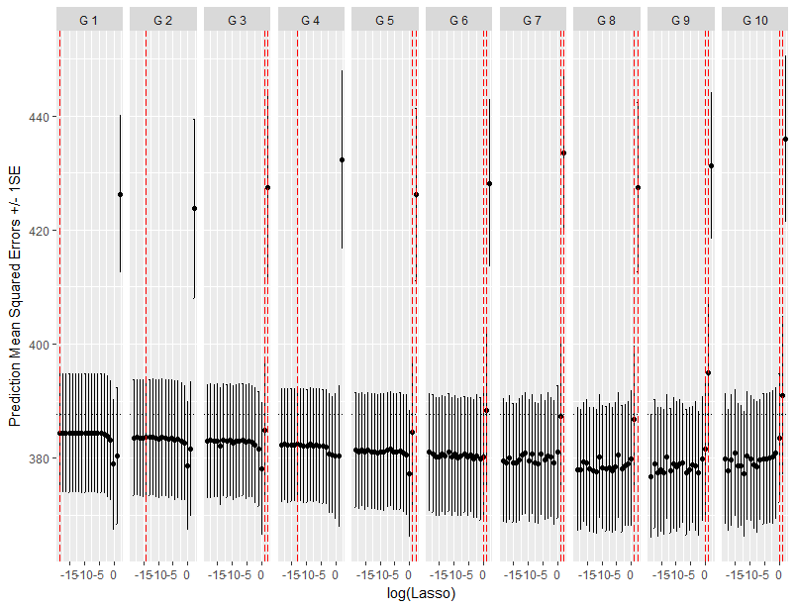
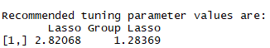
Model selection: Cross-validation for both group lasso and lasso tuning parameters

Slide 38
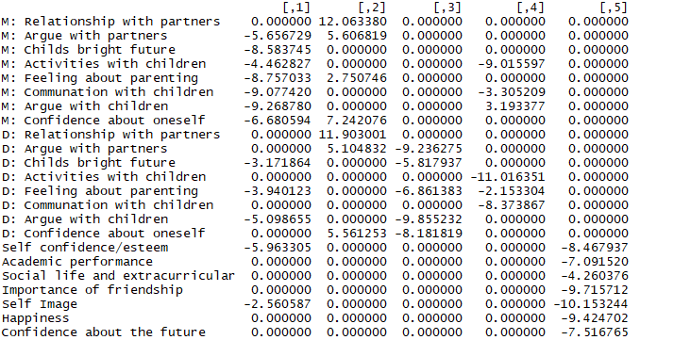
Common
Parents
Father
Parents
Child

Slide 39
Illustration: A meaningful linear model for high-dimensional prediction
Method: SPCovR (~PCR/PLS)
Find early (day 3) genetic signature that predicts flu vaccine efficacy (day 28) (public data: Nakaya et al., 2011)
transcript₂
transcript_{g}
transcript₅₄₇₁₅
titer
transcript₁
. . .
. . .
1
1
.
.
.
.
.
24
2
.
.
.
X
y
i
.
.
.
24

Slide 40
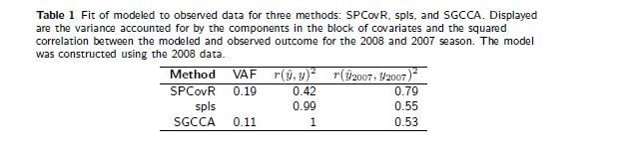
Comparison of results with sparse PLS
$r\left(\hat{y},y\right)²$ for elastic net = 0,06 (200 non-zero coefs, tuned with CV using glmnet)

Slide 41
DISCUSSION

Slide 42
We presented a generalization of sparse PCA to the multiblock case
Sparsity can be imposed accounting for the block structure
Sparsity can be imposed either on the weights or the loadings
Note: best recovery for generated with sp.loadings and estimated with sp.weights
Different algorithmic strategies possible: here coord. descent considered, we have also used MM in a previous life
 | Fit | Stability estimates | Comput. Effic.
Sparse weights | + | - | -
Sparse loadings | - | + | +

Slide 43

Much to learn, we still have

Slide 44





Thx to the cool people!
Mr. Regularized SCA
Mrs. SNAC
Mr. Sparse W
Mr. Clusterwise sparse CoCo
Mr. Compare

Slide 45

Thank you!
&

